Slide 1
BIRTHDAY WISH AUTOMATION
GROUP FIVE

Slide 2
Table of content
Ui/Ux design
Landing page
User account
Backend
Crud operations for user
Crud operations for contacts
Crud operations for messages
birthday Automation

Slide 3
Ui/Ux design
Landing page
User account

Slide 4
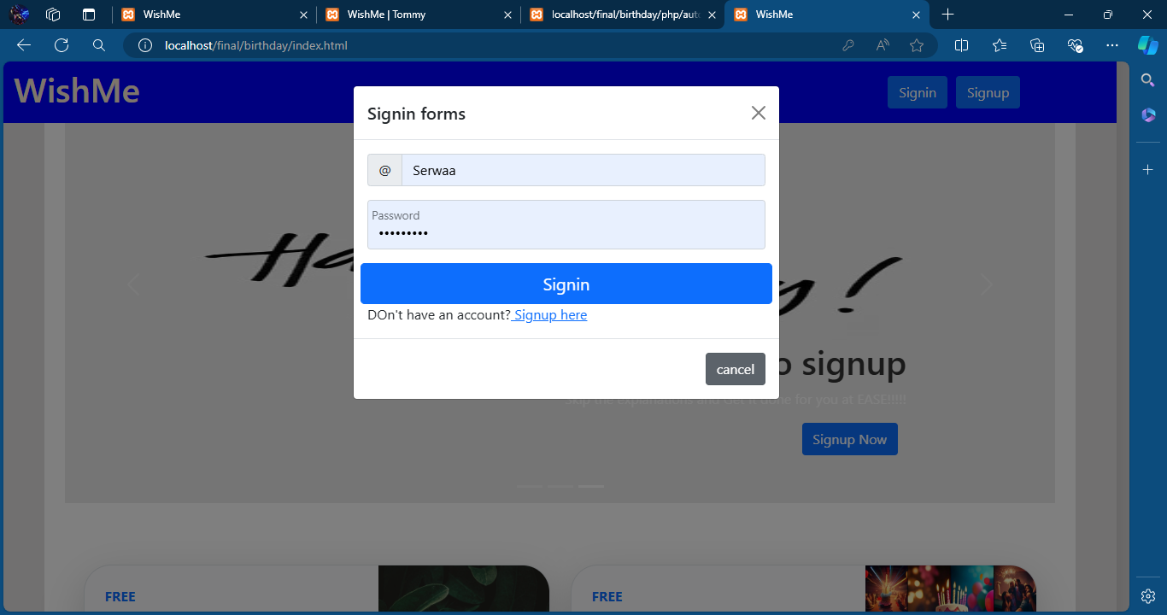
Landing page

Slide 5
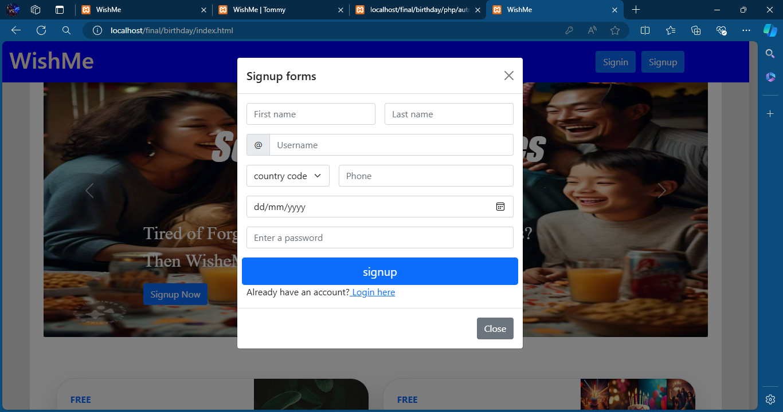
Landing page

Slide 6
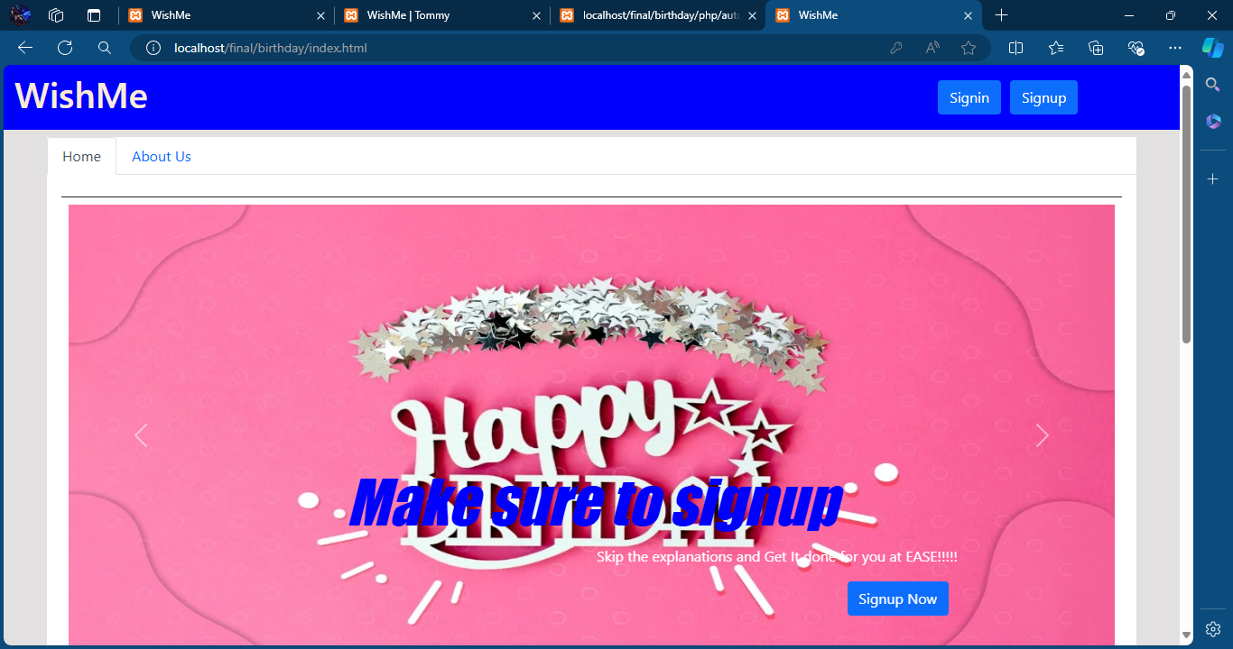
LANDING PAGE

Slide 7
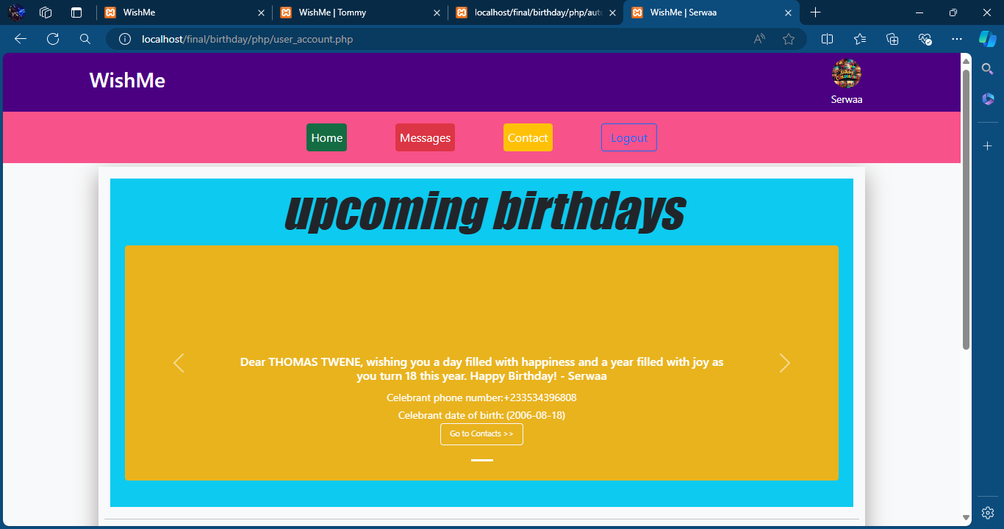
USER ACCOUNT

Slide 8
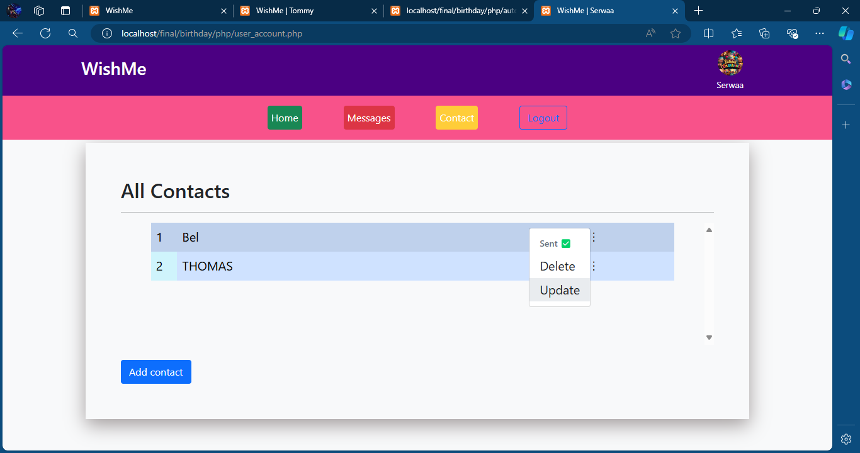
USER ACCOUNT

Slide 9
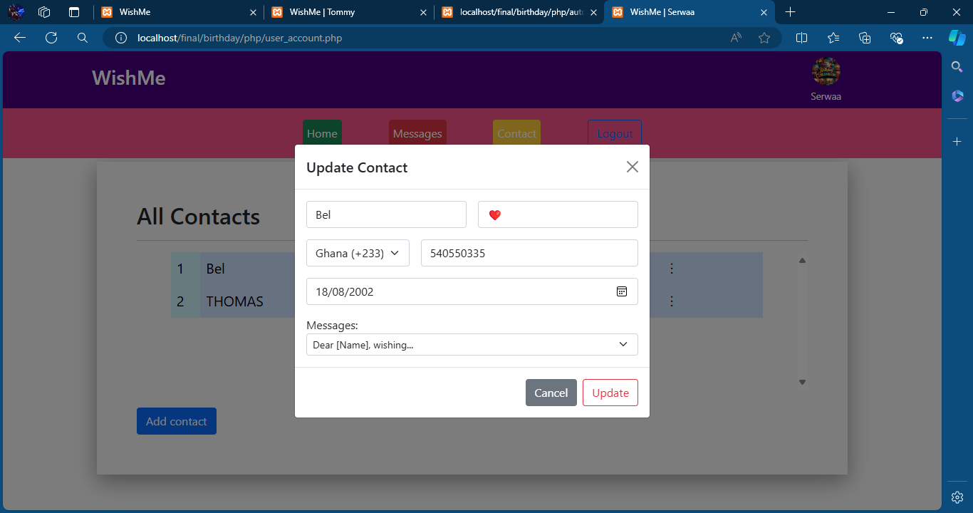
USER ACCOUNT

Slide 10
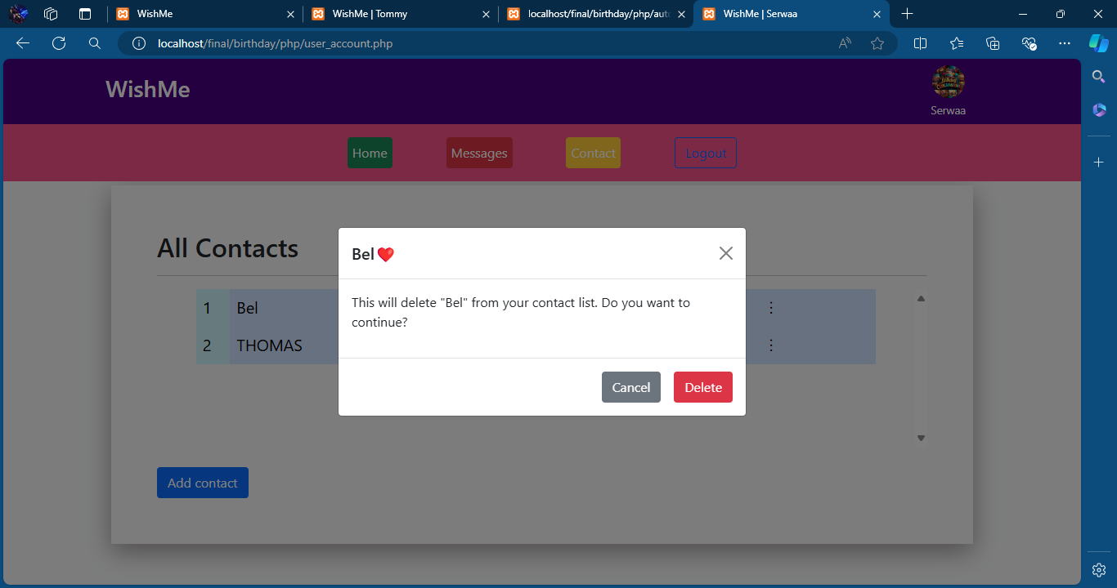
USER ACCOUNT

Slide 11
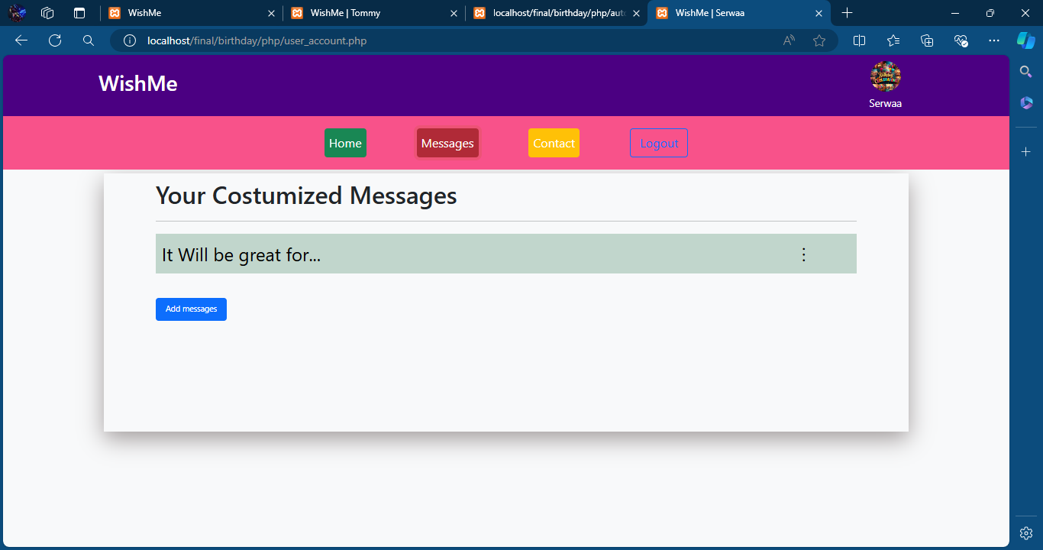
USER ACCOUNT

Slide 12
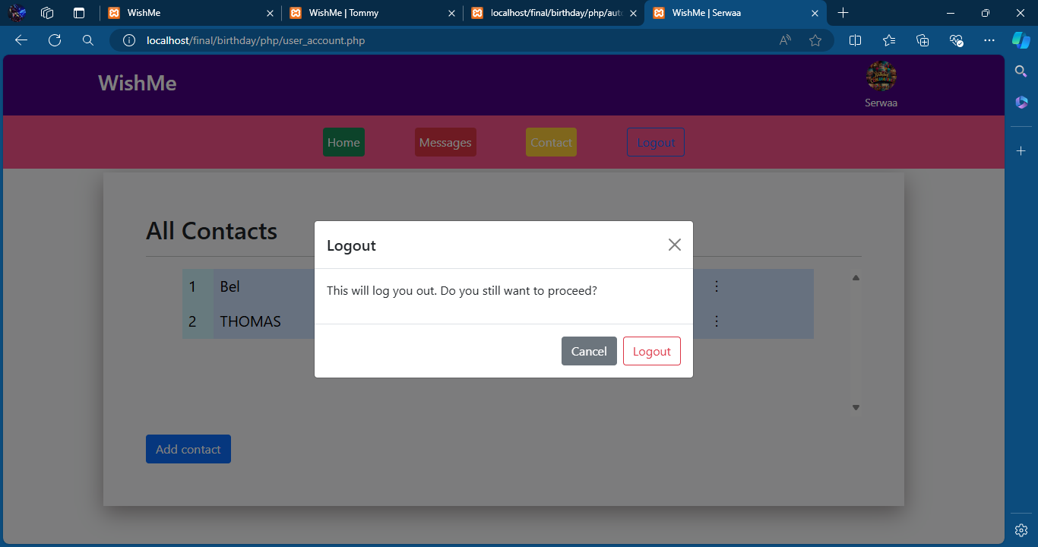
USER ACCOUNT

Slide 13
Backend
Crud operations for user
Crud operations for contacts
Crud operations for messages
birthday Automation

Slide 14
Crud operations for user
Algorithm for user registration
Signup
As soon as user enters information and clicks on signup, signup.php retrieves the data that has been inputted into a variable(that is whatever value you equate name to )
It sanitizes the information we have using real_escape_string which is a function defined in the mysqli class
It then uses a mysqli_query to input the data we have accepted into the database and return a status message
Finally if every validation successful , it automatically logs the user in and creates a new session with session variables message, name and id.

Slide 15
Crud operations for user
Algorithm for user registration
Login
As soon as user enters information and clicks on Login, Login.php follows the same line of thought as signup but only takes username and password
It then verifies the password entered with the one already in the table using password_verify
Since it was hashed with password_hash
If all validations are successful it logs the user in and creates a new session with session variables message, name and id.

Slide 16
Crud operations for contacts
Algorithm for Contact Creation
Create contact
It uses the same syntax as creating a new user but in this case we just need name, contact number, the message you want to send and the birthdate.

Slide 17
Crud operations for contacts
Algorithm for Contact Update
Update contact
It provides the user with values that are related to the contact he/she wants edited that is name birthdate etc using the contact id as reference to the data it updates the data user changes automatically in the database.

Slide 18
Crud operations for contacts
Algorithm for Contact Deletion
Delete contact
It uses the contact id to delete the contact from the database.

Slide 19
Crud operations for messages
Algorithm for messages
It works the same way from creating to deleting the message just that in this case its only the messages we edit.

Slide 20
birthday Automation
Algorithm for birthday Automation
This checks for the users that have a birthday currently and using the bmsnotify api automatically send personalised messages to the contact .

Slide 21
USER ACCOUNT
REFERENCES
FRAMEWORK USED: BOOTSTRAP 5
IMAGES GENERATED BY AI
LANGUAGES USED : PHP,CSS,HTML,MYSQLI

Slide 22
GROUP 5 MEMBERS
Thomas Twene Appiah
Forster Boadu
Derrick Daffour
Daniel Amemo
Serwaah Achiampong Lydia
Rashid Saeed
Isabela Anane
Rita Johnson
Frimpong Obed Ebo
Daniel Kwabena Onwosi
Bismark Osei
Albert Baiden-Amissah
George Kpodo
Aikins George Nana
Erica Narh
Gilbert Adzaho
Agyabeng Benjamin
Sarpong Nana Kofi Kelvin
Molokwu Emmanuel
Mark Afedi
Hamza Habib
Nana Kwame

